Slide 1


Human - Computer
Interaction
Present by Chi Nguyen

Slide 2
CONTENTS
Introduction
  What is HCI
  Roots & Branches
  The multidisciplinary field of HCI
HCI - evolution of UX design
Why HCI is important?
The career related to HCI
Project’s process

Slide 3
WHAT IS HCI?
An academic discipline
Studying people interacting with (computer) technology
A design discipline
Designing interventions for systems involving people & technology

Slide 4
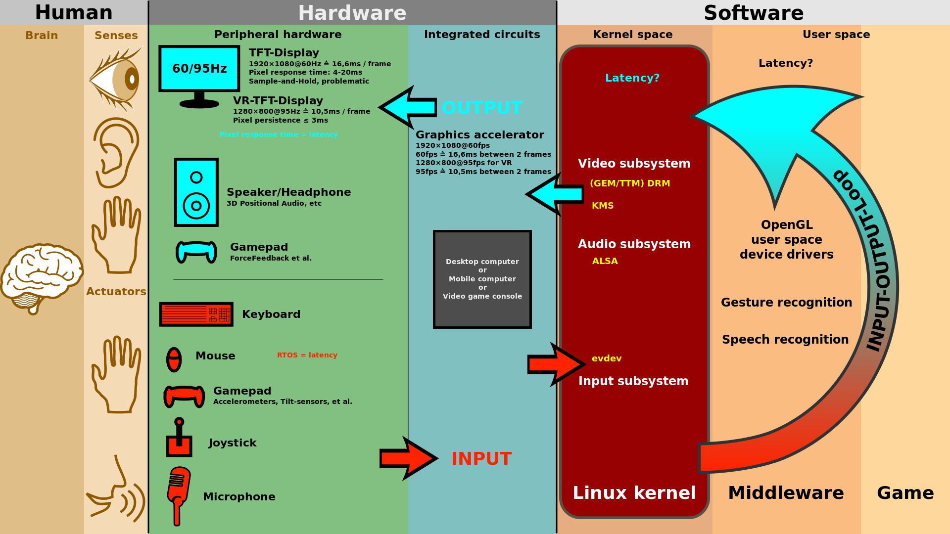

Slide 5
MANY ROOTS
COMPUTING
PSYCHOLOGY
HCI
SOCIOLOGY
BUSINESS & MANAGEMENT
etc...

Slide 6
MANY BRANCES
VISUALISATION
CSCW
COMPUTER SUPPORTED COOPERATIVE WORK
HCI
UBIQUITIOUS COMPUTING
E-LEARNING
etc...

Slide 7
DESIGN - THREE “USE” WORDS
USEFUL
  Functional, does things
USABLE
  Easy to do things, does the right, enjoyable, UX
USED
  Attractive, available, acceptable to organization

Slide 8
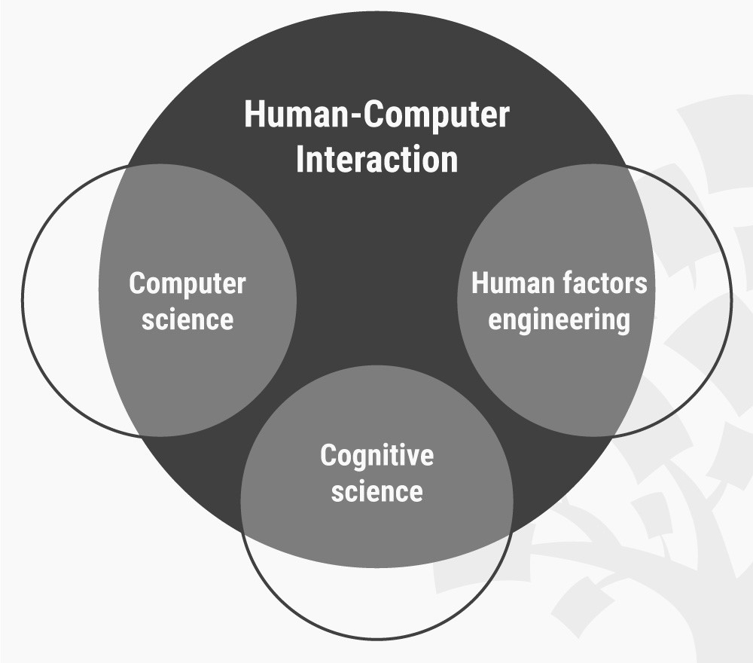
THE MULTIDISCIPLINARY FIELD OF HCI

Slide 9
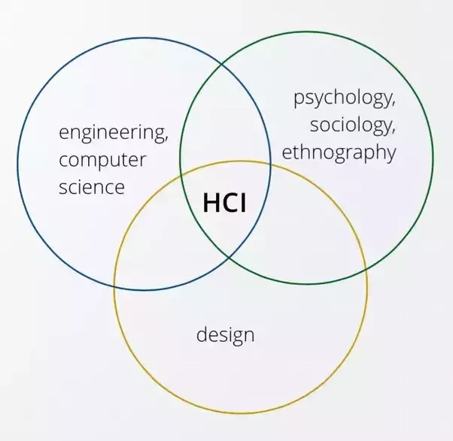
THE MULTIDISCIPLINARY FIELD OF HCI

Slide 10
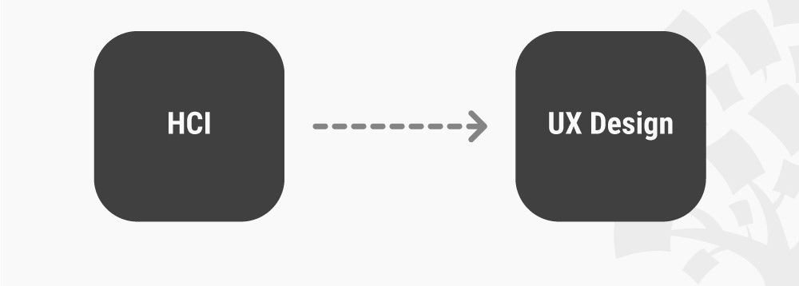
THE EVOLUTION OF UX DESIGN

Slide 11
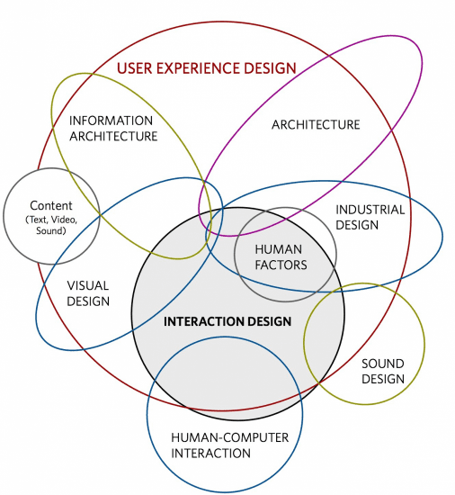
The UX Value of HCI and Its Related Realms

Slide 12
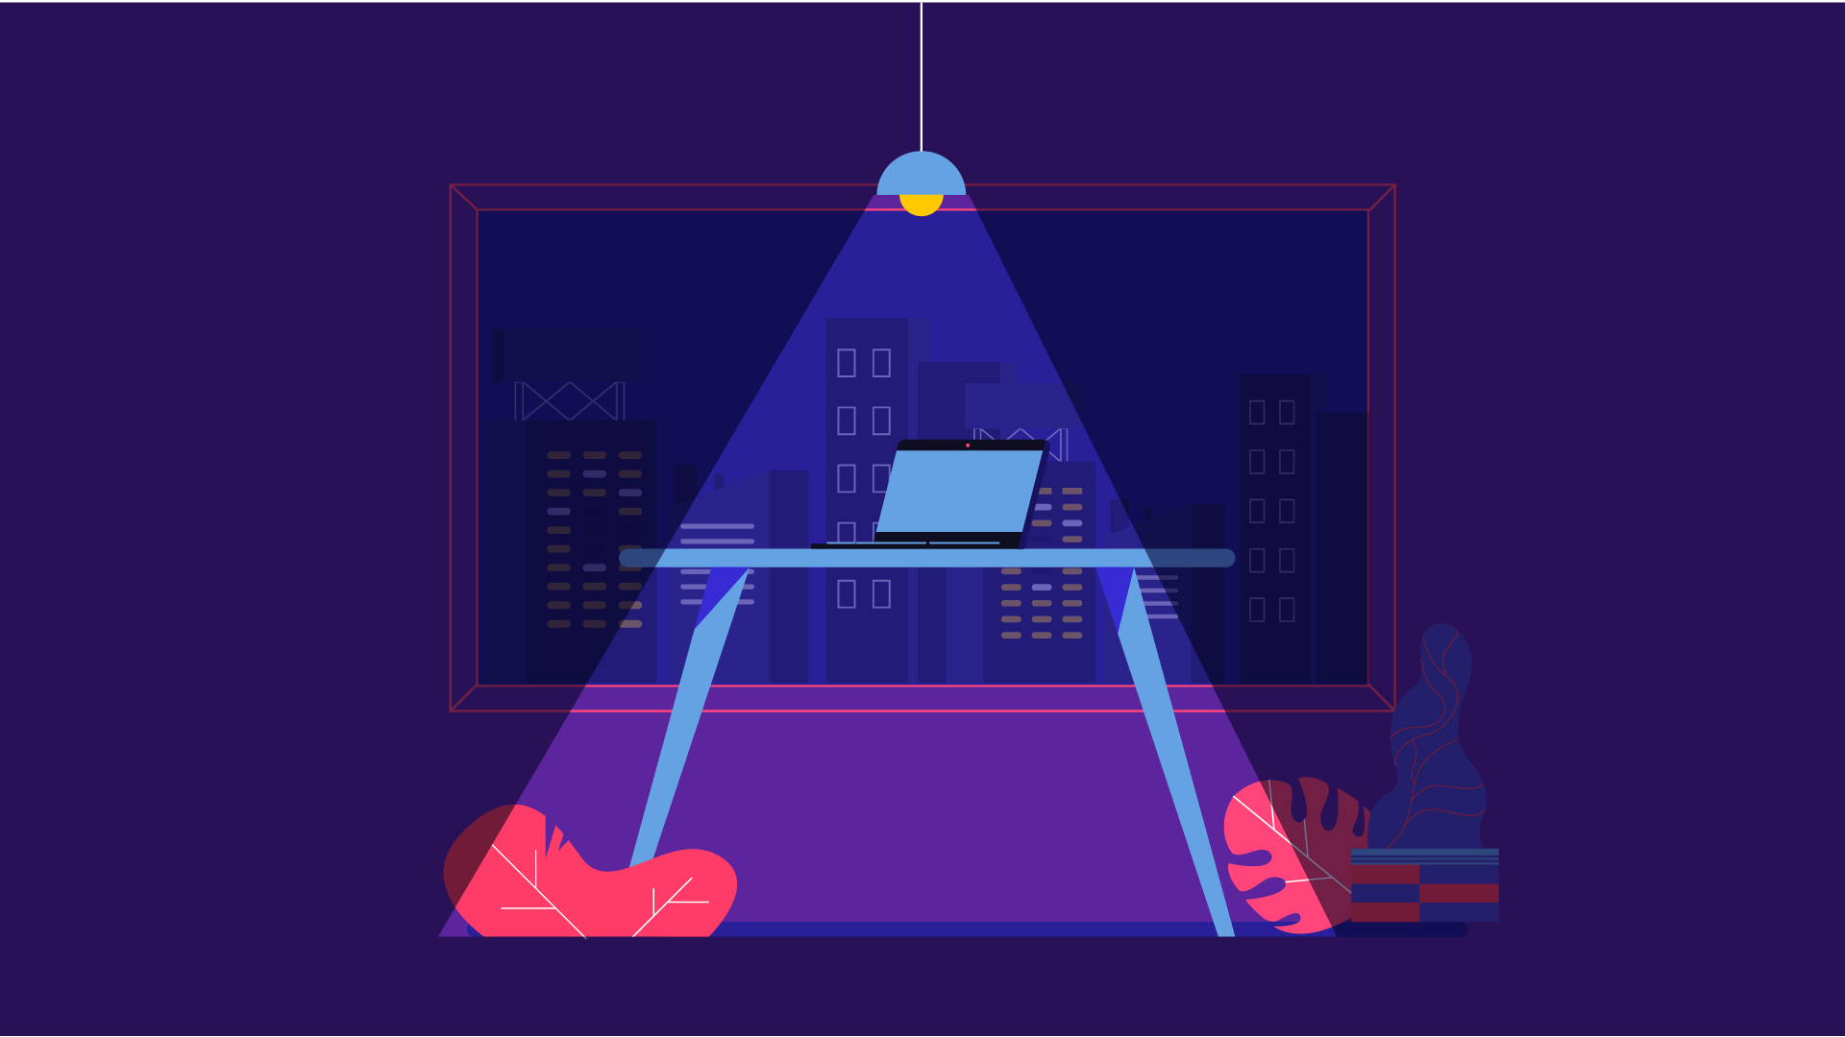
WHY HCI IS IMPORTANT?

Slide 13
WHY HCI IS IMPORTANT?

Slide 14
WHY HCI IS IMPORTANT?
Human-computer interaction (HCI) is a multidisciplinary subject that focuses on computer design and user experience. It brings together expertise from computer science, cognitive psychology, behavioural science, and design to understand and facilitate better interactions between users and machines.
HCI is about doing things better
HCI will shape the future - for better or worse
HCI has lots of career opportunities
It tackles some of the biggest threat to our future

Slide 15
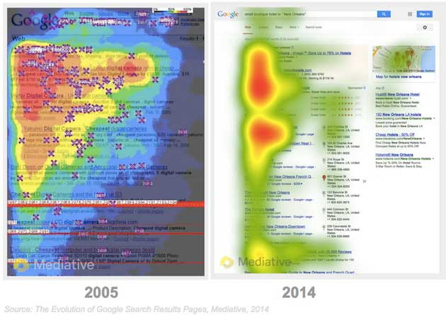
Eye- tracking

Slide 16
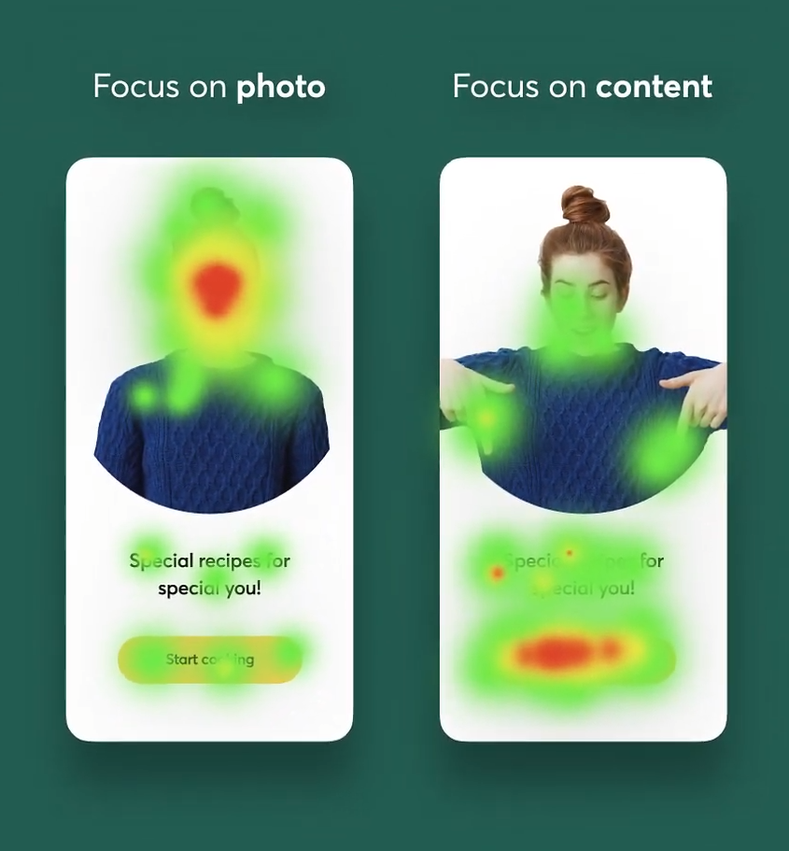
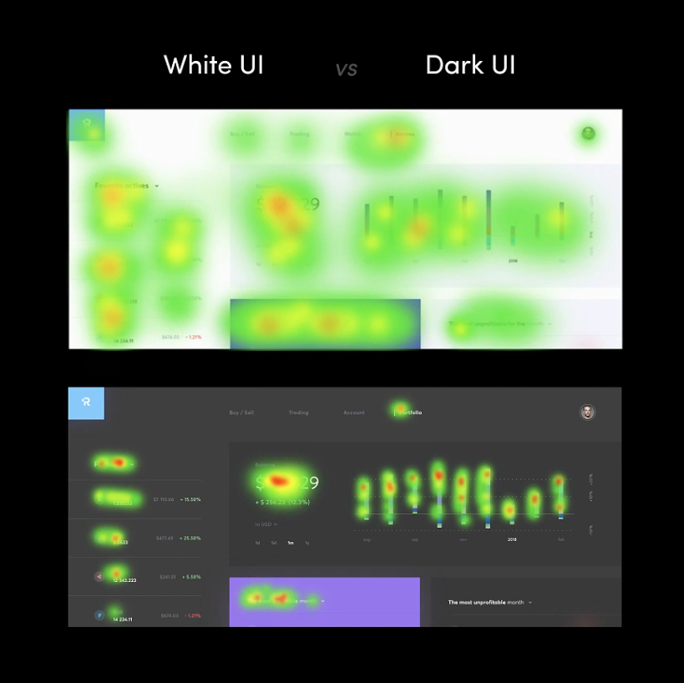

Slide 17
THE CAREER RELATED TO HCI
Interaction designer
UI
designer
UX
designer
Product
designer

Slide 18






CAREER PATH
Junior
Senior
Manager
Role that do not require prior experience in
the field
Be an expert and support juniors.
Manage task, No longer responsible for the work. But for the team
Interships
Middle
Leader
A short term job with limited responsibility
Good at what you do.
Experienced one
Be an expert in your field and Responsible for others.

Slide 19
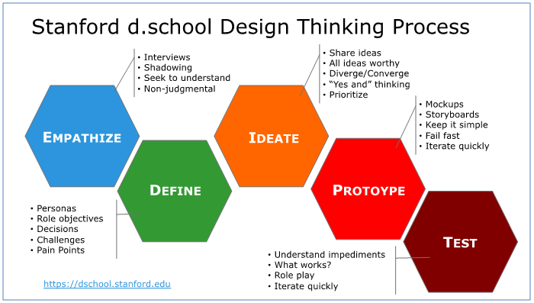
DESIGN THINKING PROCESS

Slide 20
PROJECT’S PROCESS
Use
cases
User
stories
Flow
Customers
Visual
style
Mockup
Usibility test
Brand
Goals
RESEARCH
(brief)
INSIGHT
&
ANALYSIS
UX
(Concept/
Ideate)
UI
DESIGN
DEVELOP
Business
Vision
Wireframe
Prototype
Personas
Motion
design
Graphic quality check
UX designer
PRESENT TO CLIENTS & TEAM
Dev Back-end
UI designer
Dev Front-end

Slide 21


Thanks!
Do you have any questions?
chrizmonkey@gmail.com
+84 0937 566 561

